Slide 1

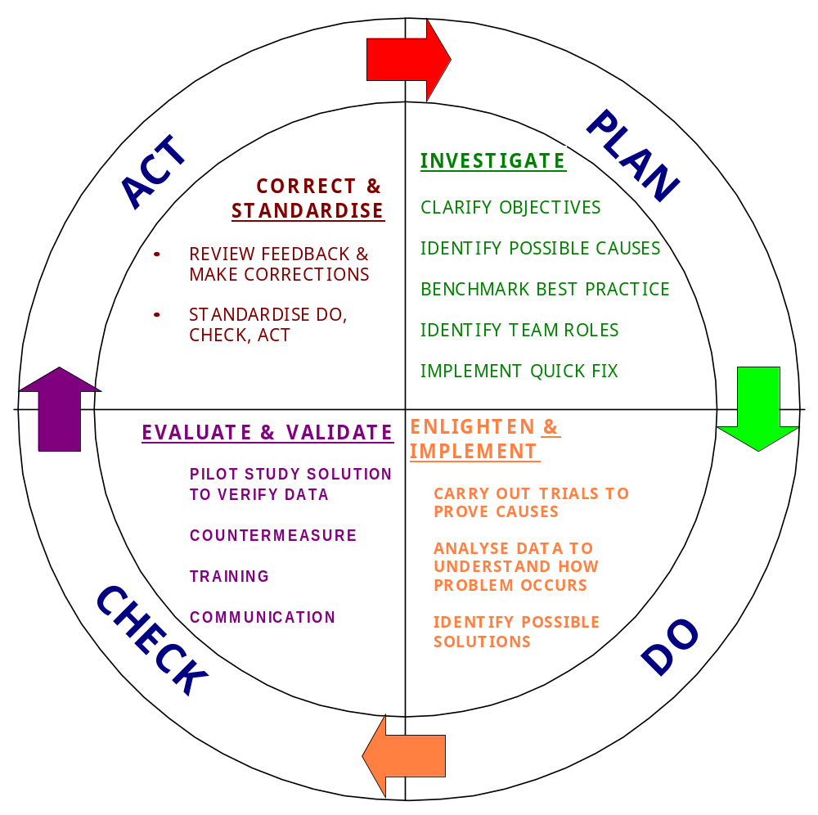
PDCA
Problem Solving Guide
A Simplified Guide to a Team Approach to Problem Solving
S D BELLAMY - Group Total Quality Manager - 22 August 2000 ( 6TH Revision - Short Health Version )

Slide 2
Contents
1 Introduction to PDCA Problem Solving Cycle.
2 PDCA Cycle…….
3 Key Steps in PDCA…..
4 A Guide Through the Process
5 Selection of Techniques used in PDCA.
6 Using the 7 Techniques.

Slide 3
Introduction to PDCA
PDCA was created by W Edwards Deming in the 1950’s as an easy to follow Problem Solving Cycle.
Deming was tasked with helping Japan rebuild its economy in the 1950’s.
His purpose was to use PDCA with a Continuous Improvement process to help rebuild Japanese industries so that they could compete in the world market in the future.

Slide 4
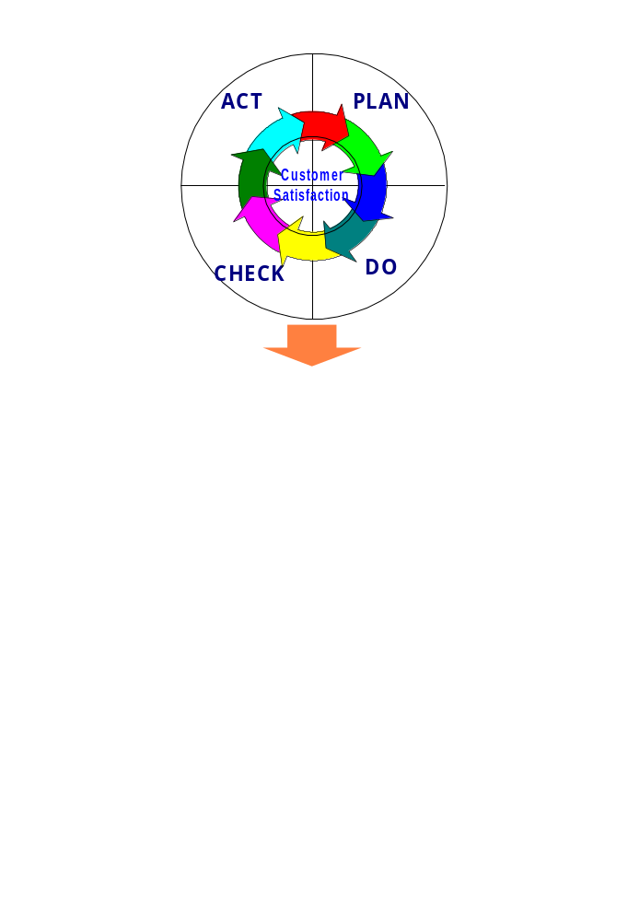
PDCA Problem Solving Cycle

Slide 5
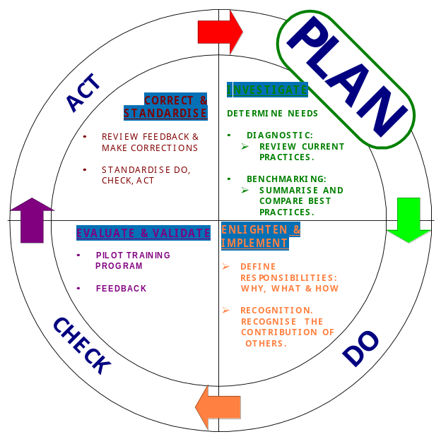
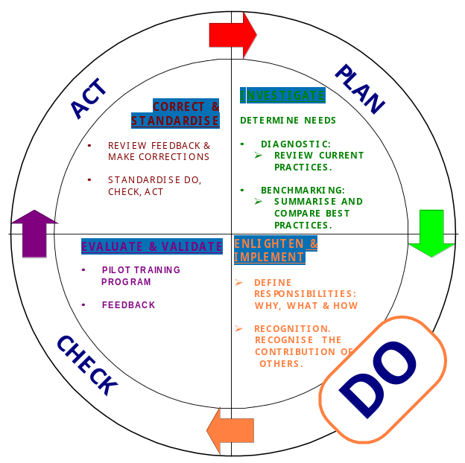
Purpose:- To INVESTIGATE the current situation & understand fully the nature of the problem being solved.
Purpose:- To Enlighten the Team as to the Real Problem by analysing the Data and defining and implementing a solution plan.
Notes:
hgvvh

Slide 6
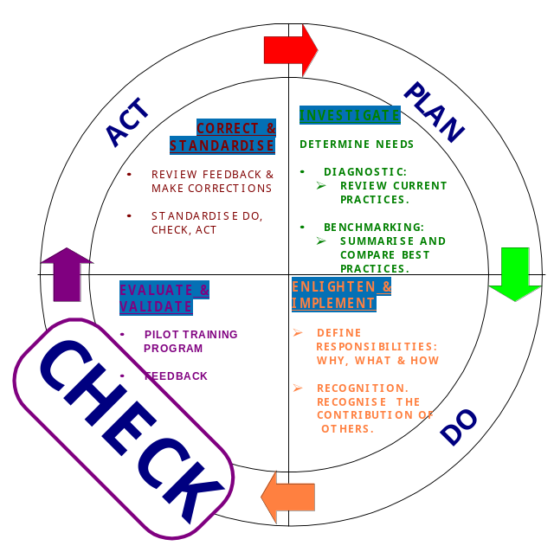
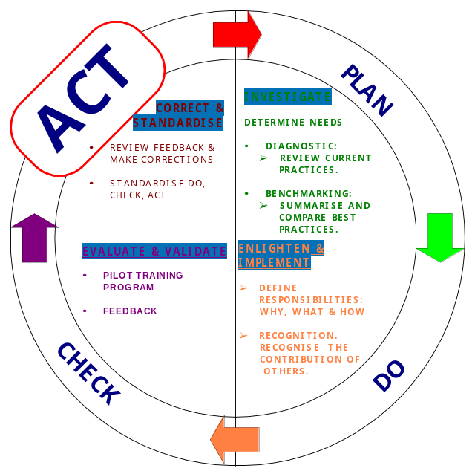
Purpose:- To monitor effect of implementation of project plan & find Countermeasures to further improve the solution.
Purpose:- To Review Continuously the Performance Measure & make adjustments as required. Integrate new situation into Normal Working Practice. Start PDCA Cycle again.

Slide 7
ACT
PLAN
Customer
Satisfaction
CHECK
DO
Problem Solving Steps
Technique
Define the
Problem
Smart Objective
Determine the
Possible Causes
of the Problem
Brainstorming
List the 10 most likely
causes in order of
importance
Cause and Effect
Diagram
Calculate the degree
of ease of change and
level of impact of change
Impact Assessment
Identify the root causes
5 Whys
Determine what can be
monitored to verify causes
Checklists and
things you can count
Use the information to determine
the three most significant causes
Top 3
Monitor the effects of the changes
Checklists and
things you can count

Slide 8
YOUR PDCA
WORKSHEET
Write your Answers in Here
The problem is :-
Your SMART
Objective
BRAINSTORMING and
CAUSE and EFFECT
The most likely causes are
1.
2.
3.
4.
5.
6.
7.
8.
9.
Your
IMPACT ASSESSMENT
Shows these are the easiest
to fix and give the
greatest impact
1.
2.
3.
1.
2.
3.
4.
5.
6.
7.
8.
9..
The
5 WHYS
Shows these are the
ROOT CAUSES

Slide 9
YOUR PDCA
WORKSHEET - Page 2
Write your Answers in Here
1.
2.
3.
4.
5.
These methods have been
used to collect data
1.
2.
3.
The TOP 3 causes to
be tackled have been identified
from the data collected
1.
2.
3.
4.
5.
These methods have been
used to Monitor the
Effect of Any Changes

Slide 10
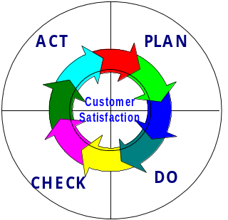
Techniques to use with PDCA - Selection Chart
Technique
P
D
C
A
1
SMART OBJECTIVE
✓
2
BRAINSTORMING
✓
✓
✓
✓
3
CAUSE & EFFECT
✓
✓
4
IMPACT ASSESSMENT
✓
✓
5
5 WHY'S
✓
6
CHECKLISTS AND THINGS YOU
CAN COUNT
✓
✓
✓
✓
7
TOP 3 ANALYSIS
✓
✓

Slide 11
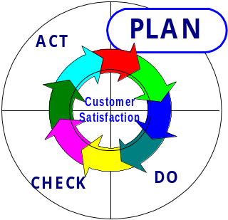
Defining the Problem in SMART form.
What is this ? It is the first step in the PDCA problem solving cycle.
Why do it ? To ensure that the whole Team is clear about what their Goal is.
When do I use it ? At the first Team meeting.
Who does this ?. The Team.
How de we do it ?
By considering each of the following aspects of the issue being addressed.
Who is the problem experienced by ( Stakeholder )?
What is the problem ?
Where is the problem ?
When is the problem experienced ?
Use these statements as a “Sanity Check” to refer back to at later stages of the project to check if on track.

Slide 12
Writing a Team Mission Statement in SMART form.
Write a statement using the following SMART rules.
Specific
Measurable
Achievable
Realistic
Time based
Examples
To reduce “Annual Lost working Days due to Back related Problems” in the “Stores Department” by 50% in 6 months.
To reduce “Risk of causing Back Related Injuries” in the Packing Department by 30% in 5 days.

Slide 13
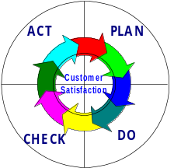
Technique 2 - BRAINSTORMING
What is it ?
- It is a method of generating Ideas or suggestions very
quickly and creatively.
Why do it ?
- So every member of the Team contributes.
Where is it used ?
- Most often in the Team room, and otherwise anywhere that
there is a Team and a Flipchart.
When is it used. ?
- Usually when the problem being solved is identified and
defined.
W
ho u
ses it ?
- Can involve anyone.
How is Brainstorming Done ? -
STEP 1
Ÿ
Find a quiet room with a
Flip Chart
and have
Pens , Post Its, Drywipe Markers,
Blue Tac
available.
Ÿ
Decide who will act as the
Team Scribe.
Ÿ
Write down the
Problem or Situation
being Studied or Investigated at the
TOP
of a Flip Chart.
STEP 2
Ÿ
Give all the Team Members a few Post Its.
Ÿ
Then
individually
for 5 minutes write down on the Post Its ( 1 idea per sheet )
any
ideas or suggestions.
Ÿ
When ideas have dried up, Stick all the ideas onto a Flip Chart and
Group
any
similar ideas.
Ÿ
Then for up to 10 minutes , working around the room , add any further ideas
that may have been missed.
STEP 3
✓
As a Team discuss each idea and decide if they are
Totally, Partially or
Not
in the Control of the Team.
✓
Separate out the
"Totally"
ideas.
✓
Prioritise them using
" Impact Assessment"
STEP 4
✓
The Team must decide if there is a need to involve someone else, in the
Team, to resolve the
Partially or Not in Control
items.

Slide 14
Technique 3 - CAUSE & EFFECT
W
hat is it ?
-
It is a method of
Brainstorming Causes
of a problem or situation.
Why do it ?
-
To help the Team can focus on specific themes and groups of causes .
Where is it used ?
- In the team room or at place of work
When do we use it ?
- When a problem or effect is defined and possible causes are
needed.
Who uses
it
?
- Everyone.
How do we use them ? -
Step 1
- On a large board or flip chart. Construct the diagram below.
MAN
MACHINE
Write the Effect in
here.
Step 2
MATERIAL
METHOD
Dried up.
- A Scribe Will take
POSSIBLE CAUSES
from round the table in Turn until
As per example below.
MEN
Operator not Trained
Machines
Lifting Equipment unavailable
Lack of space in cab
Back Pain
Boxes too heavy
Heavy boxes in
difficult locations.
Boxes not labelled
Methods
No Post bore Gauge
Step 3
-
Materials
Prioritise and Select
those to be investigated, by allocating
VOTES
to each
Team member who add their choices to the Diagram . As per Diagram Below.
MEN
Operator not Trained
Machines
Lifting Equipment unavailable
3
5
Scales in wrong place
1
Back Pain
Boxes too heavy
Heavy boxes in
difficult locations
2
Boxes not labelled
Scales in wrong place
Materials
Methods
8

Slide 15
Technique 4 - IMPACT ASSESSMENT.
What Is It ? - It is a method by which the Team can identify the priorities of a large list of Ideas/actions or Causes...
Why use it ? -To get a Team Consensus and get the greatest Impact with least effort.
When is it used? - In cases where the is a long list of items.
Where is it used? - Team Meetings
How is it done? -
  Step1 Write all of the possible causes on to a flip chart and then
  the Team Members should (by agreement) rank against 2 -
  criteria
    1 The EASE of achieving ( 1 = Very Difficult to 10 = Very Easy ), and
    2 The IMPACT of the result ( 1 = Very Low to 10 = Very High ) on the
    problem.
    3. The EASE and IMPACT are then multiplied together and the items
    with the highest score are investigated first.
Cause
Ease Impact Score
Boxes too Heavy 4 8 32
Boxes weight not marked 6 5 30
Heavy weights in poor position 9 8 72
Shelf height set too high 10 5 50
Examine this option first

Slide 16
Technique 5 - 5 WHY’s
What is it ?
-
A very simple way of finding out
if the team has reached the
ROOT CAUSE of a problem.
Why use it ?
-
To confirm the team perception
Where is it used ?
-
As part of a team problem
solving sessions
When is it used ?
-
After initial brainstorming and
defining a problem.
Who uses it ?
-
The team.
How do we use it ?
-
5 - Why's
Simply ask the question
"WHY"
5 times
1)
WHY
will TV not come on ?
Because there is no power.
2)
WHY
is there no power?
Because the fuse has blown.
3)
WHY
has the fuse blown.?
Because the fuse amp rating is to low.
4)
WHY
was the fuse amp rating too low?
Because it was incorrectly selected.
5)
WHY
was it incorrectly selected?
Because the house holder was ignorant
understanding)
of the need for correct selection.

Slide 17
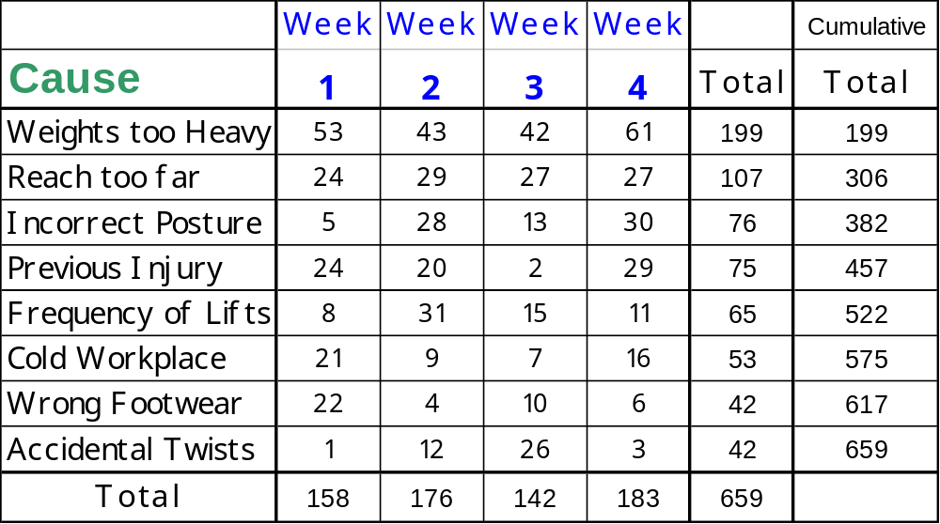
Technique 6 - CHECKSHEETS
What are they ?
-
They are a method of recording
factual data
over a period of
time.
Why do it ?
-
So you will be able to confirm the
Causes
of the problem.
Where is it used ?
-
At the place where the investigation
is taking place.
When is it used ?
-
After the initial brainstorming,
when real data is required to confirm initial ideas.
Who uses it ?
-
The team should nominate and train
volunteers to fill the sheet in.
How is it used ? -
Design a sheet similar to the one below, decide on data to
be collected and when. Train the person who will collect
the data.

Slide 18
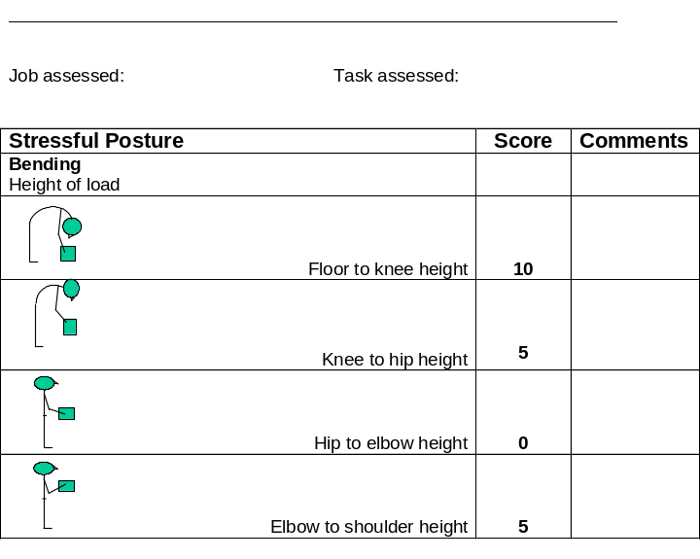
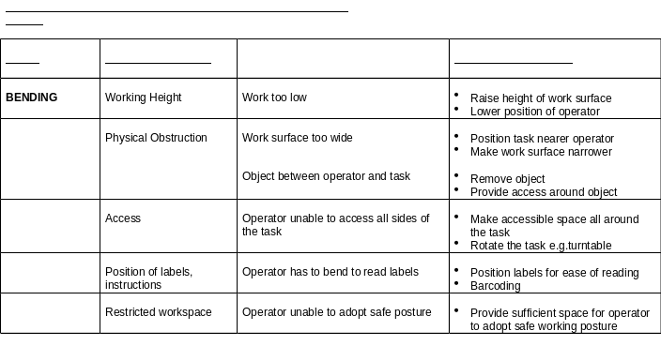
Technique 6 - CHECKSHEETS - Postural Assessment and Remedy Forms
What are they ?
Forms to help to identify areas of concern
within a task and to suggest solutions
Why do it ?
To compare the task against standards to determine
Real areas of concern and solutions
Where is it used ?
In the work place
When is it used ?
As part of finding the cause of the problem
Who uses it ?
The workforce and steering group
How is it used ? -
By observation in the workplace
Use the Checklist to determine areas of concern (Assess.doc)
See if the remedy sheet helps to remove the concern.

Slide 19
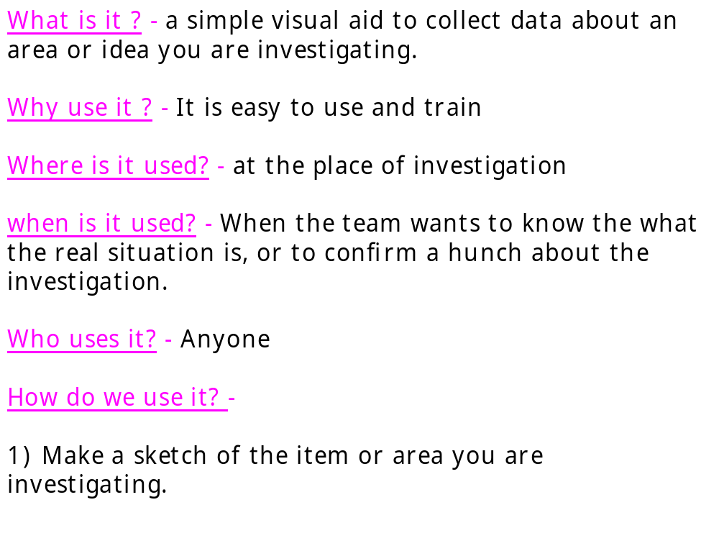
Technique 6 - CONCENTRATION DIAGRAMS - Things you can count
eg Distribution
of weights over
35 kg in racking
Simply make a mark everytime there is an occurrence of a
problem in that location.
The resulting visual impact is easy to see

Slide 20
Technique 7 - TOP 3
What is it ? -
A method of determining what areas to
concentrate on
Why do it ? -
This is based on pareto analysis where 80%of the
problem is caused by only a few causes
Where is it used ? -
On notice boards, in departments at
place of work to show why things are being tackled.
When is it used ? -
After you have collected real data in
checksheet form.
Who uses it ? -
Anyone.
Examine the issues in RED first (3 highest values )
How do we use it ? -
( Using data in technique 3. )
Week
Week
Week
Week
Cumulative
Cumulative
Cause
1
2
3
4
Total
Total
%
%
Weights too Heavy
53
43
42
61
199
199
30.19727
30.1972686
Reach Too far
24
29
27
27
107
306
16.23672
46.4339909
Incorrect Posture
5
28
13
30
76
382
11.53263
57.9666161
Previous Injuries
24
20
2
29
75
457
11.38088
69.3474962
Frequency of Lifts
8
31
15
11
65
522
9.863429
79.2109256
Cold Workplace
21
9
7
16
53
575
8.042489
87.2534143
Wrong Footwear
22
4
10
6
42
617
6.373293
93.6267071
Accidental Twists
1
12
26
3
42
659
6.373293
100
Total
158
176
142
183
659
100
90
80
70
60
50
40
30
20
10
0
Weights too Heavy
Reach Too far
Incorrect Posture
Previous Injuries
Frequency of Lifts
Cold Workplace
Wrong Footwear
Accidental Twists

